Slide 1


Neuro-Endocrine Tumoren
De Appendix in het Bijzonder
Wouter W. de Herder
Inwendige Geneeskunde
Endocrinologie
ENETS Center of Excellence
Erasmus MC
Rotterdam
Notes:
1
1

Slide 2
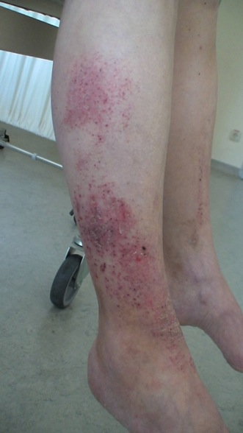
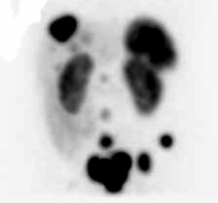
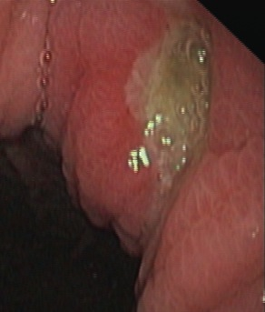
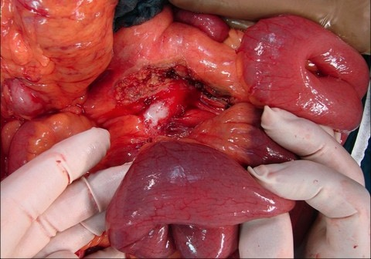
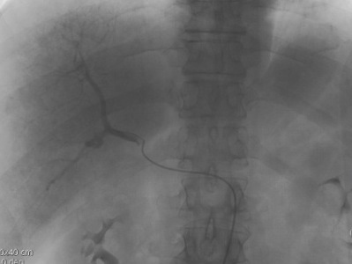
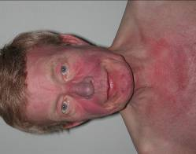
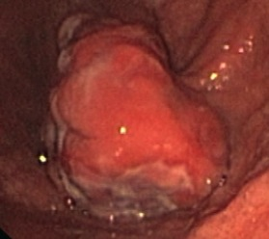
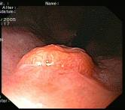
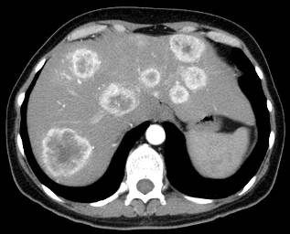
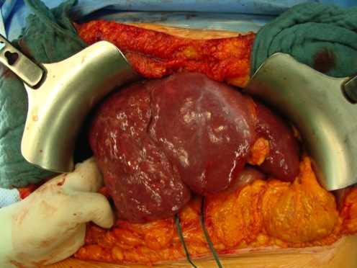
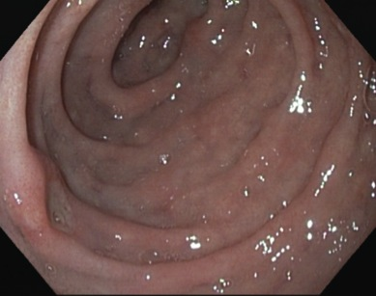
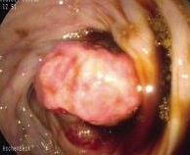
NeuroEndocrine Tumor(s): One (?) Disease, Many Face(t)s!

Slide 3
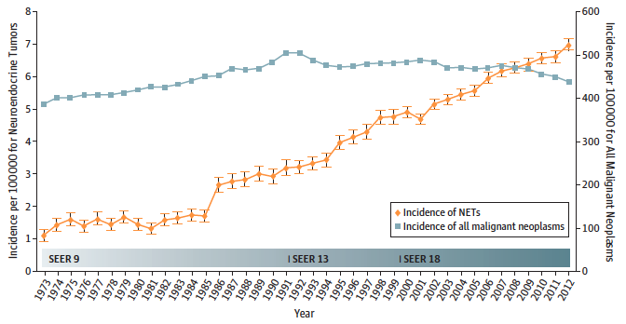
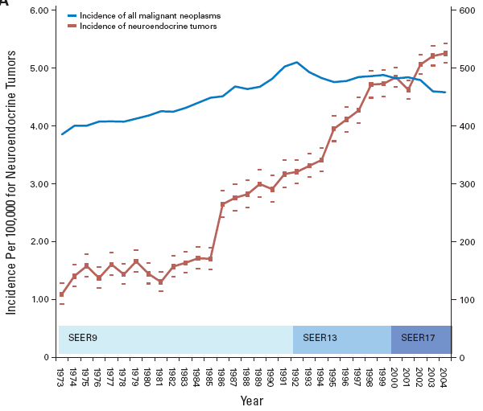
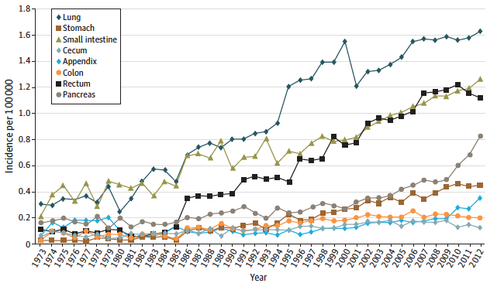
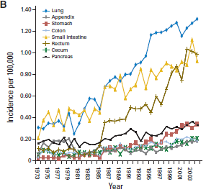
NeuroEndocrine Tumor(s): On the Rise!
Dasari A, et al. JAMA Oncol. 2017;3(10):1335-1342.

Slide 4
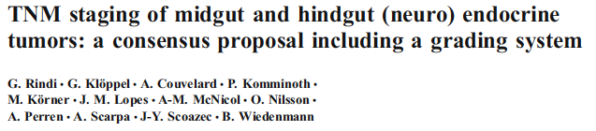
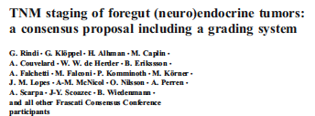


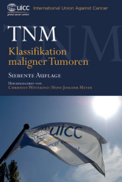
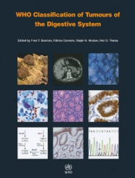
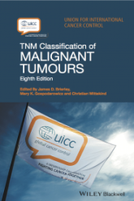
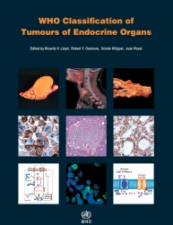
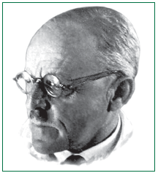
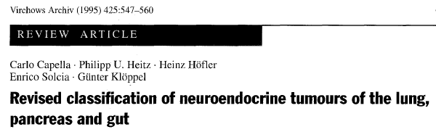
NeuroEndocrine Tumor Classification:
As Time Goes By…
WHO
2000
AJCC/
UICC
WHO
2010
UICC & WHO
2017
Siegfried Oberndorfer
WHO 1980
ENETS
1907 1963 1980 1995 2000 2006/7 2009 2010 2017
AJCC: American Joint Committee on Cancer; ENETS: European Neuroendocrine Tumor Society; UICC: Union for International Cancer Control

Slide 5
Three-tier System for GI NeuroEndocrine Tumors
Neuroendocrine tumor, NET G1
(Well-differentiated)
Neuroendocrine tumor, NET G2
(low-grade malignant)
Neuroendocrine tumor, NET G3
Neuroendocrine carcinoma, NEC
small type
large cell type)
Mixed neuroendocrine-nonneuroendocrine neoplasias (MINEN)
(high-grade malignant)
Lloyd RV, et al. WHO Classification of Tumours of the Endocrine Organs, 2017
Notes:
5
5

Slide 6
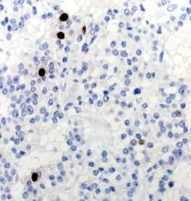
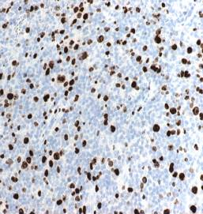
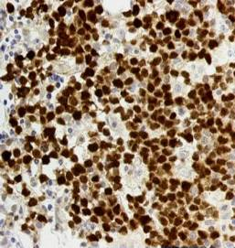
NeuroEndocrine Tumor Grading System using Ki-67
Ki67
< 3 %
3% - 20 %
> 20 %
Grade
G1
G2
G3
Lloyd, RV, et al. WHO Classification of Tumours of the Endocrine Organs, 2017.
Images courtesy of Prof. A. Scarpa.
Notes:
6

Slide 7
ENETS
UICC/AJCC
TNM Classification and Disease Staging for Appendiceal NeurEndocrineTumors
(T) Primary Tumor
Primary Tumor (T)
TX
Primary tumor cannot be assessed
T0
No evidence of primary tumor
T1
Tumor ≤ 1 cm with infiltration of the submucosa and muscularis propria
T1a tumor ≤ 1 cm, T1b tumor > 1 cm but ≤ 2 cm
T2
Tumor ≤ 2 cm with infiltration of the submucosa, muscularis propria and/or minimal (≤ 3 mm) infiltration of the subserosa and/or mesoappendix
Tumor > 2 cm but ≤ 4 cm or with extension into the caecum
T3
Tumor > 2 cm and/or extensive (> 3mm) infiltration of the subserosa and/or mesoappendix
Tumor >4 cm or with extension into the ileum
T4
Tumor with infiltration of the peritoneum and/or other neighboring organs
Tumor with perforation of the peritoneum or invasion of other adjacent organs
(N) Regional Lymph Nodes
Regional Lymph Nodes (N)
NX
Regional lymph nodes cannot be assessed
N0
No regional lymph node metastasis
N1
Regional lymph node metastasis
(M) Distant Metastases
Distant Metastasis (M)
MX
Distant metastasis cannot be assessed
M0
No distant metastasis
M1
Distant metastasis/es
AJCC: American Joint Committee on Cancer; ENETS: European Neuroendocrine Tumor Society; UICC: Union for International Cancer Control

Slide 8
Determinants of NeuroEndocrine Tumor Diagnosis
Age.
Gender.
World region & race.
Primary tumor localization.
Advancement of NEN disease.
Available diagnostic/screening programs.
Standardized use of diagnostic/classification criteria.

Slide 9
Appendix Carcinoid / NeuroEndocrine Tumor
> 0.15-0.16/100.000/year (25-30/year NL).
1/100 – 300 appendectomies – even distribution within the appendix.
Females > Males.
Mean age at diagnosis 38-51 years (4th decade).
Diagnosis by post-surgery histology.
  Local disease: 5-Year Survival Rate > 95%.
  Regional disease: 5-Year Survival Rate > 85%.
  Distant metastases (extremely rare: 5-Year Survival Rate < 25%!!).
Goblet cell carcinoid ≠ NET.

Slide 10
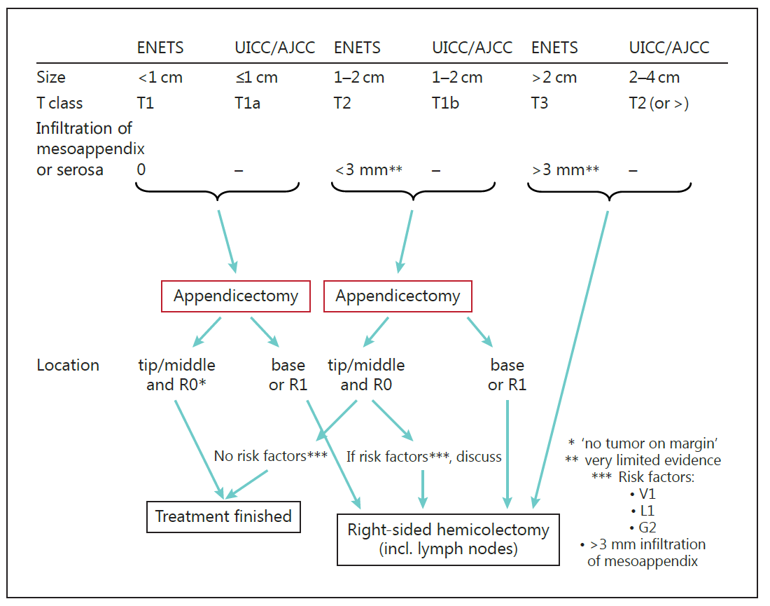
Appendix NeuroEndocrine Tumor – Surgical Therapy
Vascular invasion
Lymphatic invasion
G2 = Ki67: 3-20%
Pape U, et al. Neuroendocrinology. 2016;103:144-152.

Slide 11
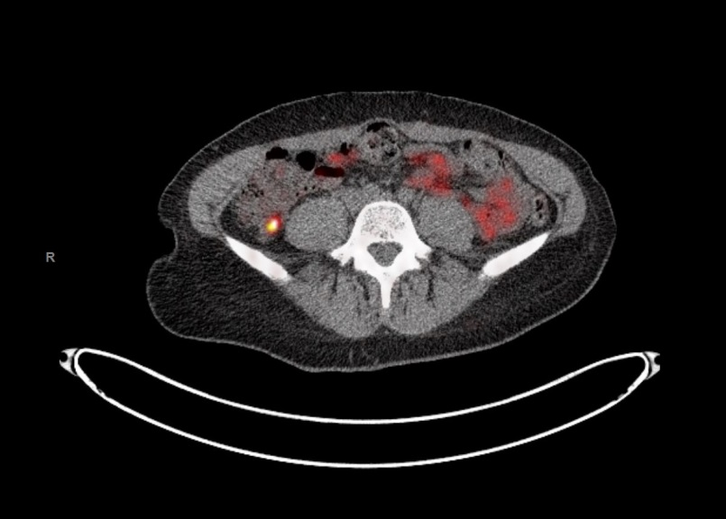
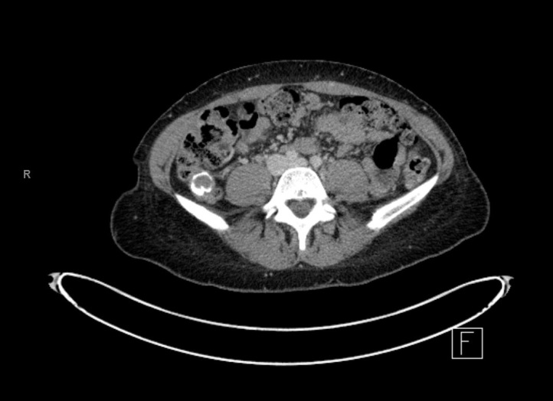
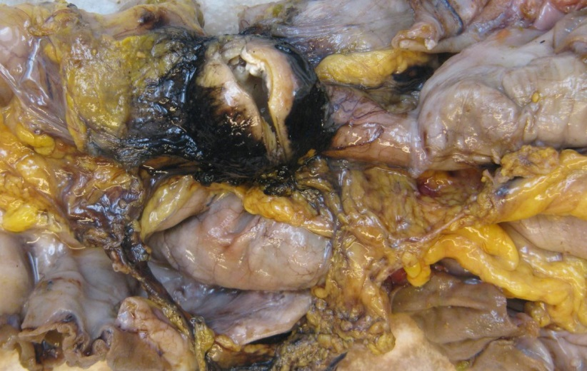
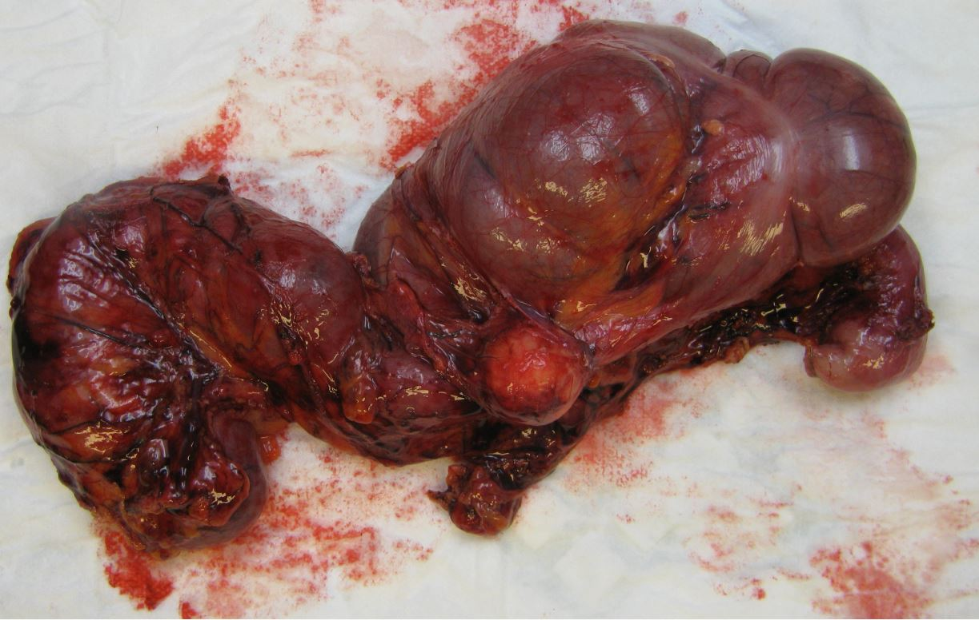
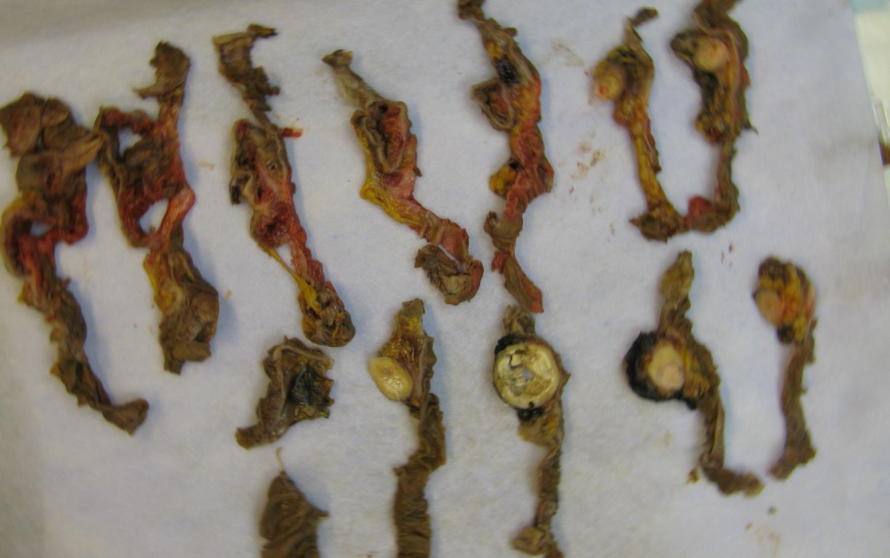
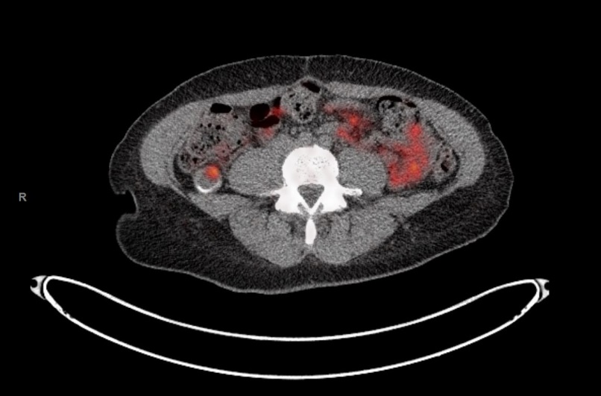
Appendix NET – Imaging - Surgical Therapy
CT
⁶⁸Ga-DOTATATE PET-CT
Laparoscopic right hemicolectomy: T1N1M1
0030948

Slide 12
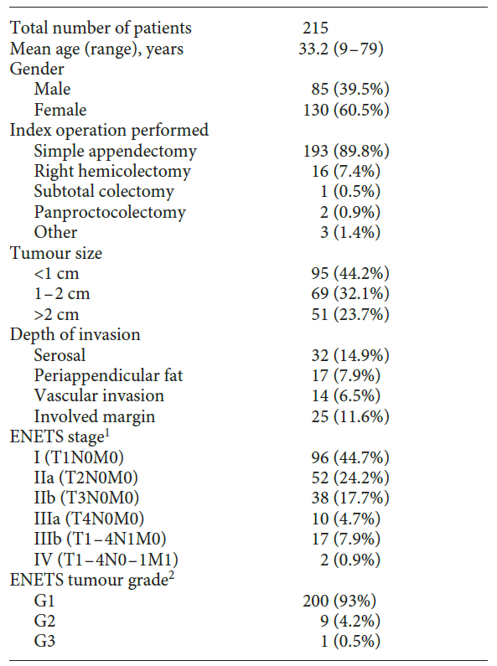
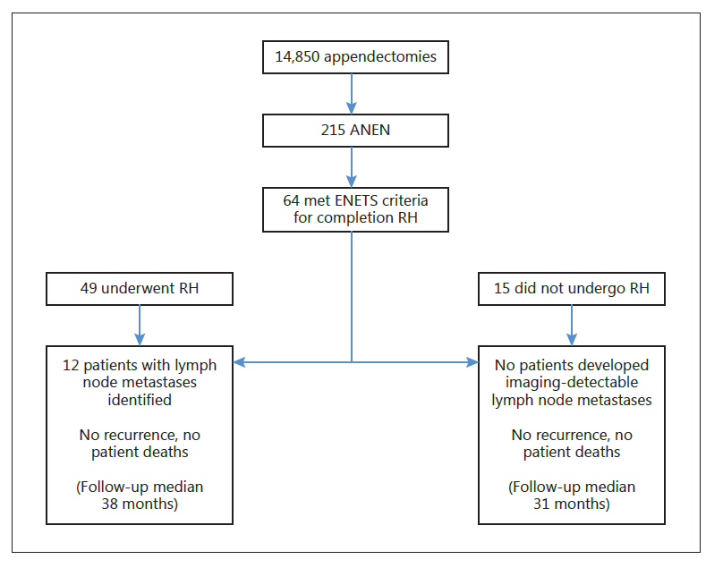
Appendix NET – Surgical Therapy
ANEN: appendiceal neuroendocrine neoplasm
RH: right hemicolectomy
ENETS: European Neuroendocrine Tumor Society
Pawa N, et al. Neuroendocrinology. 2017.

Slide 13
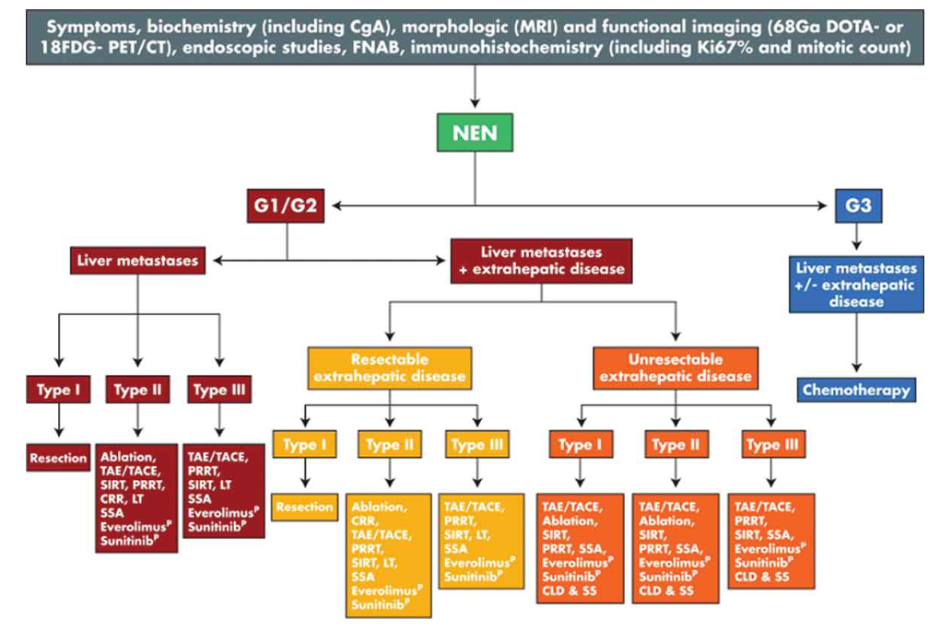
Metastatic, ENETS Stage IV Appendix NET - Therapies
CgA: chromogranin A
MRI: magnetic resonance imaging
⁶⁸Ga-DOTA: ⁶⁸Gallium-DOTA
PET: positron emission tomography
CT: computed tomography
FNAB: fine needle aspiration biopsy NEN: neuroendocrine neoplasm
TAE/TACE: transarterial embolization /chemoembolization
CRR: cytoreductive resection
PRRT: peptide receptor radionuclide therapy
SIRT: selective internal radiotherapy
LT: liver transplantation
SSA: somatostatin analogues
P: used in pancreatic NEN
CLD & SS: combination of liver-directed and systemic strategies
Clift AK & Frilling A. Expert Rev Gastroenterol Hepatol. 2017;11(3):237-247.

Slide 14
Appendix Carcinoid / NeuroEndocrine Tumor
Goblet cell carcinoid ≠ NET.
Good-excellent prognosis.
Surgical overkill? (hemicolectomies).
Relevance of locoregional lymph node metastases?
Low (distant) metastatic rate.
Follow up? How? Future role for prognostic markers?
Adjuvant therapy? Who? What?
PROSPECTIVE ANALYSES NEEDED!

